Slide 1

Operating systems
Lecture # 07

Slide 2
Lecture Overview
CPU Scheduling Algorithms – Non-Preemptive
Shortest-Job-First (SJF) Scheduling

Slide 3
Key Parameters in CPU scheduling
Arrival Time (AT) | The time when a process enters the ready state (i.e., when it arrives for execution).
Burst Time (BT) | Time required by a process to complete its execution on CPU. (Time Duration not point of time)
Completion Time (CT) | The time when a process finishes its execution completely.
Turnaround Time (TAT) | The total time taken by a process from arrival to completion. (Completion Time - Arrival time)
Waiting Time (WT) | The total time a process spends waiting in the ready state (not executing). (Turnaround Time - Burst time)
Response Time (RT) | The time from when a process arrives until it gets the CPU for the first time. (First Time – Arrival time)

Slide 4
Shortest-job-first (sjf) Scheduling
A different approach to CPU scheduling is the shortest-job-firs (SJF)scheduling algorithm.
This algorithm associates with each process the length of the process’s next CPU burst.
When the CPU is available, it is assigned to the process that has the smallest next CPU burst.
If the next CPU bursts of two processes are the same, FCFS scheduling is used to break the tie.
Note that a more appropriate term for this scheduling method would be the shortest-next-CPU-burst algorithm, because scheduling depends on the length of the next CPU burst of a process, rather than its total length.

Slide 5
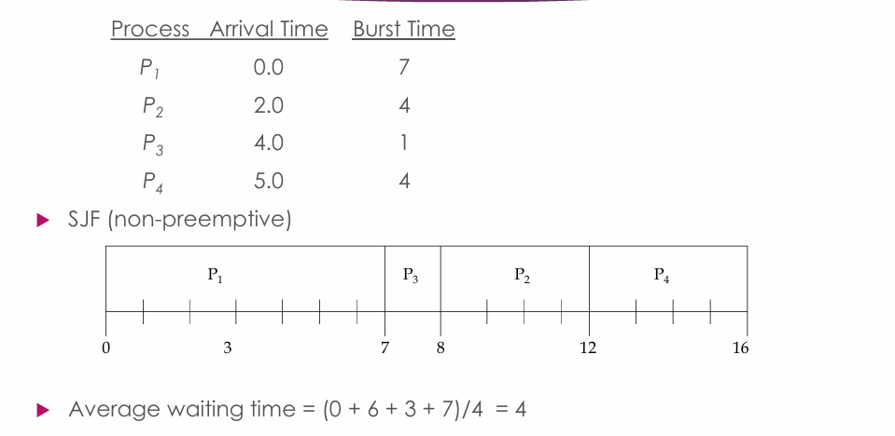

Slide 6
Shortest-job-first (sjf) Scheduling
Criteria – Burst Time
Mode - Non-preemptive
Solved Example
Process | Arrival Time (AT) | Burst Time / Execution Time | Completion Time (CT) | Turnaround Time (TAT) | Waiting Time (WT) | Response Time (RT)
P1 | 1 | 3 | 6 | 5 | 2 | 2
P2 | 2 | 4 | 10 | 8 | 4 | 4
P3 | 1 | 2 | 3 | 2 | 0 | 0
P4 | 4 | 4 | 14 | 10 | 6 | 6
Gantt Chart
CPU IDLE | P3 | P1 | P2 | P4
0 1 3 6 10 14
Time

Slide 7
Shortest-job-first (sjf) Scheduling
Question:
Consider the following set of processes with their Arrival Time and Burst Time (in milliseconds). find:
Turnaround Time (TAT)
Waiting Time (WT)
Average Turnaround Time (AVG TAT)
Average Waiting Time (AVG WT)
Total Time of Process Execution
Process | Arrival Time (AT) | Burst Time / Execution Time
P1 | 2 | 6
P2 | 5 | 2
P3 | 1 | 8

Slide 8
Thank you!
“The kernel never sleeps”

